Slide 1
Question Type Recognition for Natural Language Inputs
- Aishwarya Soni

Slide 2
What is NLP?
Natural Language processing is a way for computers to analyze, understand, and derive meaning from human language in a smart and useful way
By utilizing NLP, developers can organize and structure knowledge to perform tasks such as automatic summarization, translation, named entity recognition, question type recognition, sentiment analysis, and speech recognition

Slide 3
Problem Statement
The main task is that, given a question, we need to map it accurately to one of the k semantic classes
Example, “Who was the first woman killed in the Vietnam War?”
The above target of this question is a human, thereby reducing the space of possible answers significantly

Slide 4
Why Recognize a Question Type?
An important step in question answering (QA) and other dialog systems is to classify the question to the anticipated type of the answer
The questions are classified into broad (coarse) and fine categories
There are 6 broad categories of question types, viz. ABBREV (ABB), ENTITY (ENTY), DESCRIPTION (DESC), HUMAN (HUM), LOCATION (LOC), NUMERIC (NUM)
There are 50 fine categories of question types, viz. abb, animal, definition, group, city, count etc.

Slide 5
Why Recognize a Question Type?
The classification is of the type, BROAD_CATEGORY: fine_category
For example,
The question of “Who discovered x-rays ?” will be classified into the type of HUMAN: individual
The question of “ What is the currency of the USA?” will be classified into the type of ENTY: currency
This information would narrow down the search space to identify the correct answer string
A good classification model will help in using different strategies to find an answer

Slide 6
Need of Fine Classification
Broad classification helps in reducing the search space to a very small space thereby improving the time of response
Sometimes, determining the specific semantic type of the answer could also be beneficial in locating the answer and verifying it
Example, “Which country gave New York the Statue of Liberty ?”
Knowing that the targets are a city or country will be more useful than just knowing that they are locations.

Slide 7
Rules for Classification
Following are the rules used while labeling data,
If a query starts with Who or Whom: type Person.
If a query starts with Where: type Location.
If a query contains Which or What, the head noun phrase determines the class, as for What X questions.

Slide 8
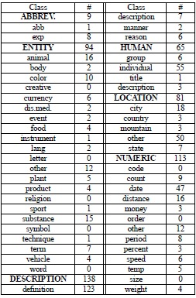
Different Question Categories
The following table shows an overview of both broad (coarse) category and fine category classes

Slide 9
Challenges
Identify the k semantic classes to predict
Difficult to find a concise answer to a question
Using advanced NLP techniques to understand the semantics of a given question rather than just extracting a key term
Parameter optimization to achieve a better accuracy
Make a scalable model

Slide 10
Related Work
Rule based approach
It uses various types of interrogative words and word combinations with different kind of features extracted by experts
Example, classical logic rules, fuzzy rules, threshold rules and prototype based rule.
Performance issues on new dataset, hence no scaling up.

Slide 11
Supervised learning
Perform the classification by extracting features from questions
Train a classifier using labeled data
Predict the class label using the trained classifier

Slide 12
Approach
1. Support Vector Machine
Find a hyperplane with maximum margin for separating classes
2. Advanced Kernel Method
Define a tree kernel which is constructed based on the syntactical structure of question
Question is first parsed to its syntactic tree and then the question will be represented based on some tree fragments which are subtrees of the original syntax tree
State of the art
Most studies assume that a question is unambiguous, that is, it has only one label

Slide 13
Unsupervised learning
K means clustering
Identify questions in the corpus that are similar and related to a question and group/cluster them as per their “relatedness” to the question
Use structure and lexical information to cluster questions as per their relatedness with the original question
The approach presented in the paper, http://www.cs.cmu.edu/~llita/papers/lita.acquisition-cikm2004.pdf views questions as collections of entities and relations among them
The question-type is in the form of an unknown relation or an unknown entity

Slide 14
Existing Baseline Implementation
Implement a model using supervised learning method
For the current implementation, Support Vector Classification is used whose implementation is based on libSVM
As the training samples are less, the running time for training is quite less and the accuracy is also good

Slide 15
Proposed Workflow
Question
corpus
Preprocess
Tokenize
Feature Extraction
Classifier
Question Type

Slide 16
Pre-processing-
Remove junk except for a-Z and A-Z
Change each character to lower case
Remove stop words
Feature extraction-
Words, part-of-speech (POS) tags, named entities, head chunks and semantically related words to be used as features
For semantically related words, a predefined list has been provided which has group of related words
Pos tags are extracted using a nltk pos_tag() function
To identify the question type pretrained question type classifier will be used

Slide 17

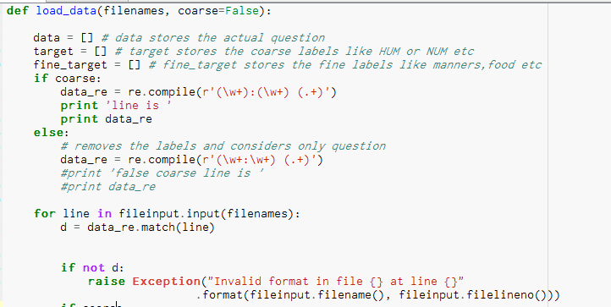
Loading Data
After loading data, it is split using a regex into labels, fine labels and actual question

Slide 18
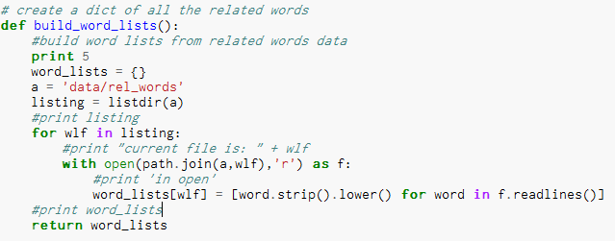
Preprocessing
Change each character to lower case

Slide 19
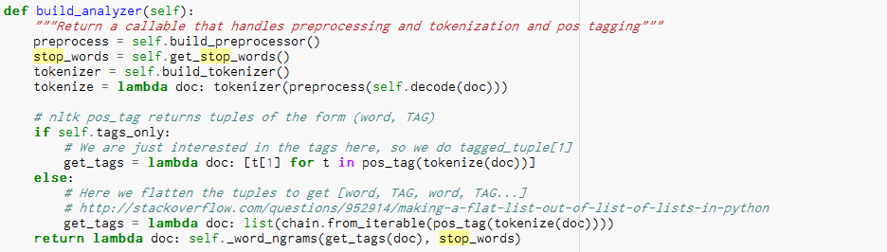
Preprocessing
Remove stop words has been done in the estimator parameter

Slide 20
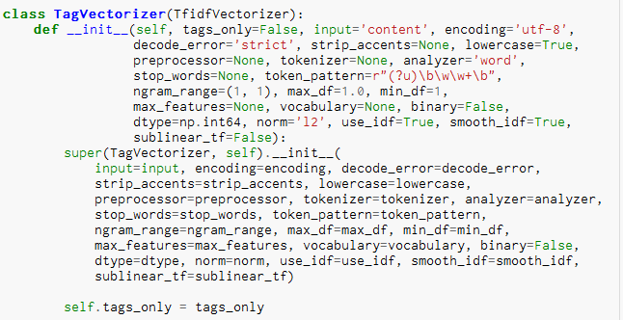
Feature Extraction
Extracting POS tags

Slide 21
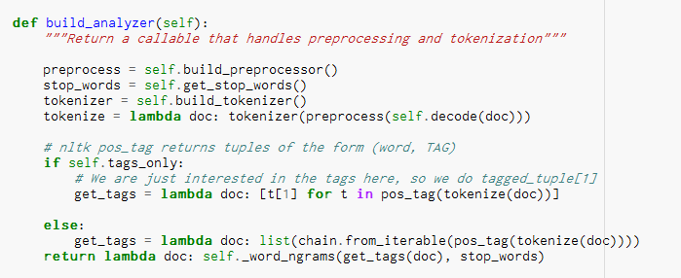
Feature Extraction
Extracting POS tags

Slide 22
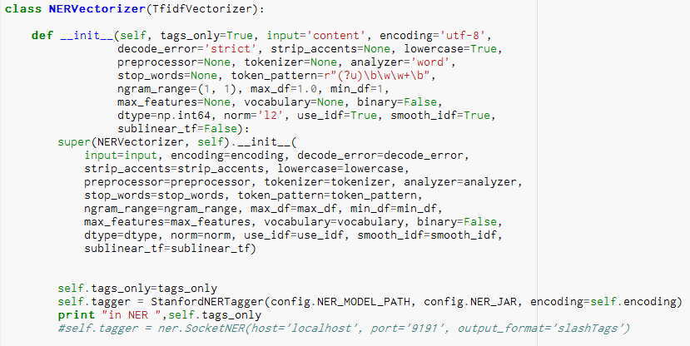
Feature Extraction
NER tagging

Slide 23
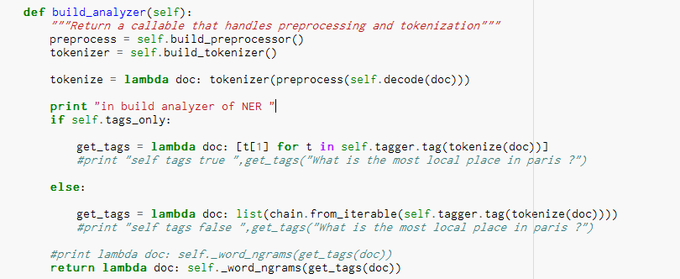
Feature Extraction
NER tagging

Slide 24
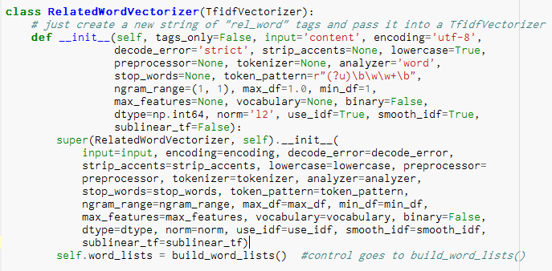
Feature Extraction
Related Word Vectorizer

Slide 25
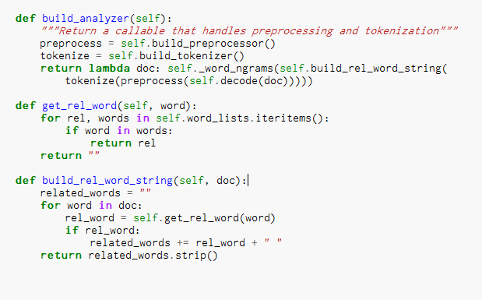
Feature Extraction
Related Word Vectorizer

Slide 26
Input for Learning
After all the pre-processing and the feature extraction phases, the data point includes
The tokenized words,
Their named entity,
POS tags for each word and,
The set of related words from the bag of words for each tokenized word
Additionally, the n-gram parameter has been set to take values between 1 to 4 while creating the model pipeline
This enhances the learning process for the model

Slide 27
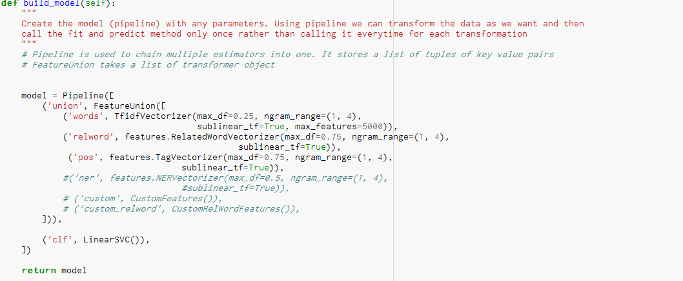
Creating Pipeline
TagVectorizer, NERVectorizer, RelatedWordVectorizer has been used as estimators which is then given to a pipeline

Slide 28
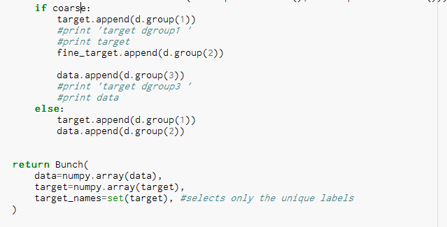
Coarse or Fine Classification
We can pass it as a parameter if we want coarse level (broad classification) filtering or fine level as an argument when we load the data
Processing is done accordingly

Slide 29
Training the Model
Stratified k-folds CV technique is used to create the train and test splits as it provides a good performance
The stratified cross-validation allows for randomization and makes sure that unbalanced datasets have some of both classes
Stratification is generally a better scheme, both in terms of bias and variance, when compared to regular cross-validation

Slide 30
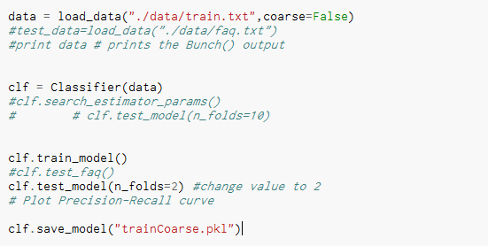
Training the Model

Slide 31
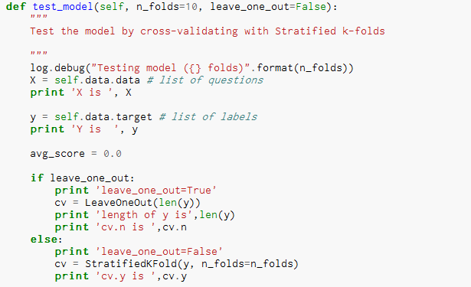

Slide 32
Custom Middleware
Initially we used wit.ai to identify the intents
Here our model is predicting the intent
Create a custom middleware to communicate with our python code

Slide 33
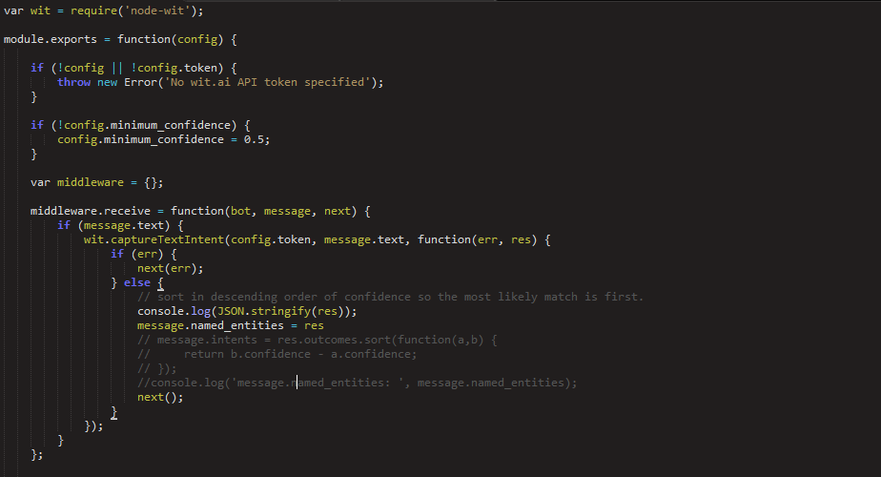
Middleware Implementation
Capture the intent

Slide 34
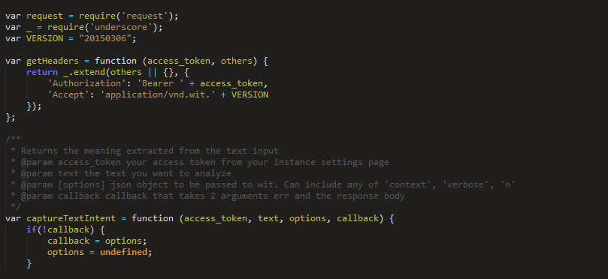
Middleware Implementation

Slide 35
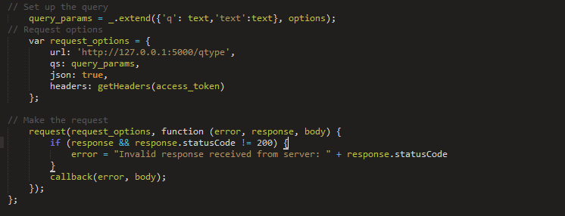
Middleware Implementation
URL is the end-point for the REST API

Slide 36
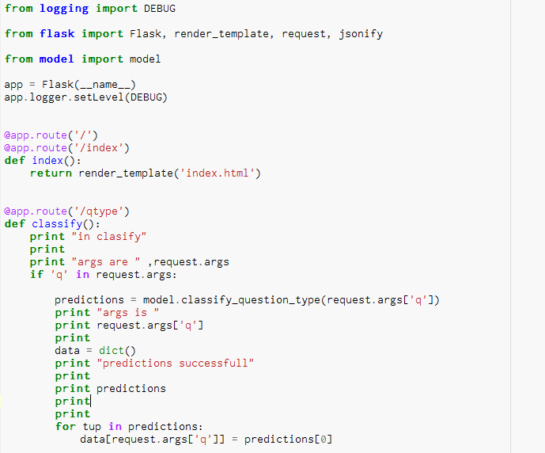
REST API Using Flask
Use python flask to convert our code as rest service

Slide 37
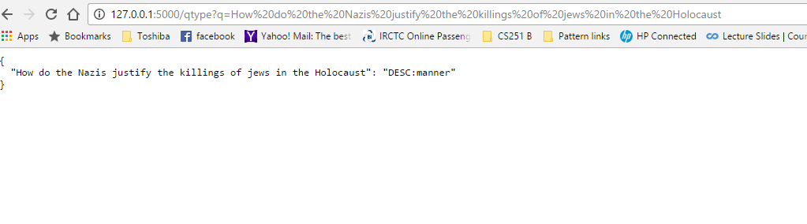
REST API Using Flask
Output of the REST service for a particular question

Slide 38
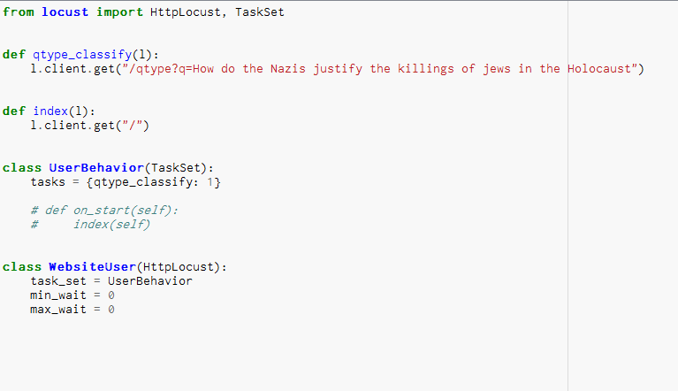
Load Testing
Aim is to test the load handling ability and to make it scalable

Slide 39
Load Testing
Specify the host address on which we have to perform load testing

Slide 40
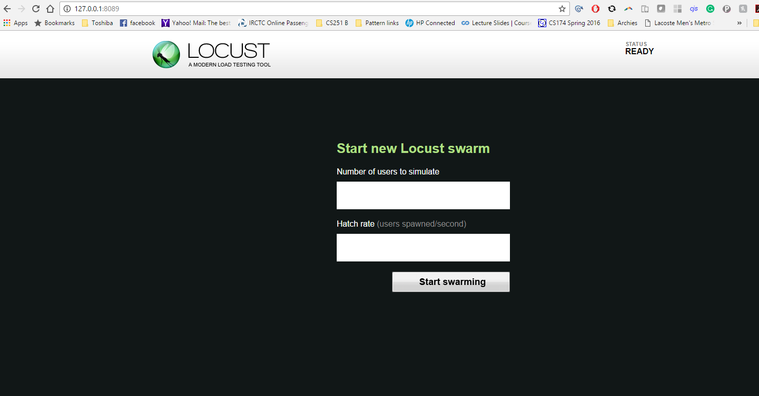
Attack Specification

Slide 41
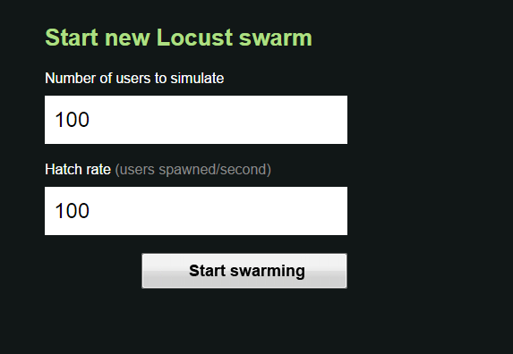
Attack Specification

Slide 42
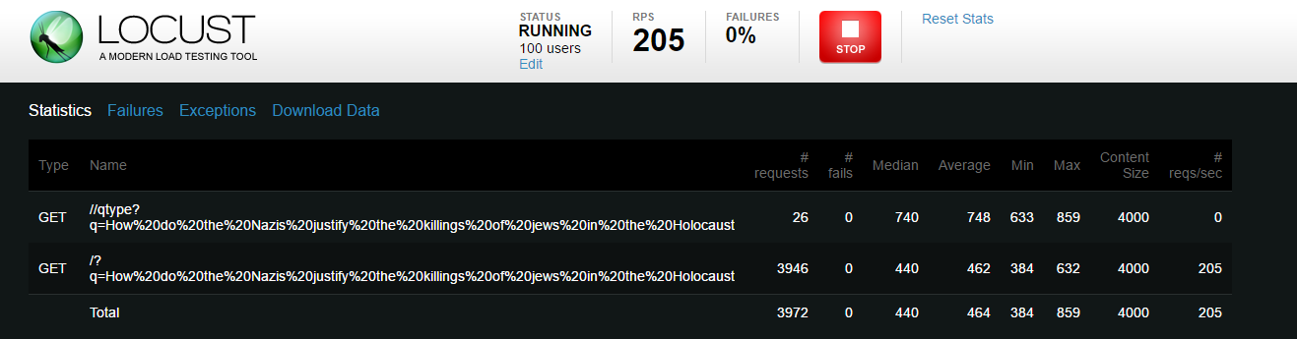
Load Testing Results
Load testing results for 100 users
As observed, the application died after 26 simultaneous requests

Slide 43

Demo

Slide 44
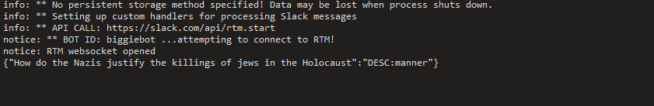
Demo

Slide 45

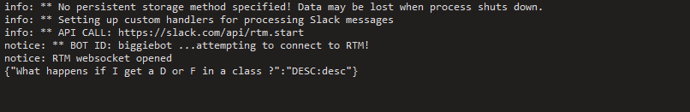
Demo

Slide 46
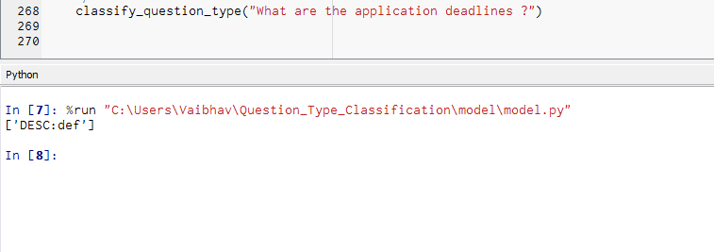
Predicting using a question from the FAQ set

Slide 47
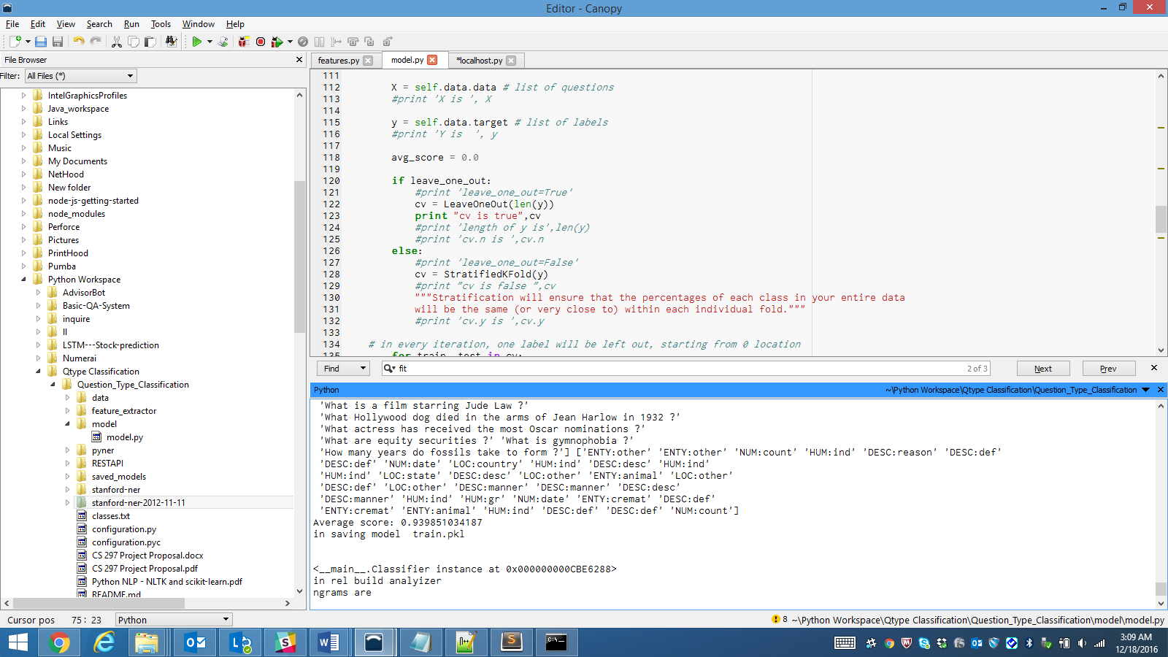
Evaluation
Average score: 93%

Slide 48
Future Work
Improve the baseline by using tuning algorithm parameters
Use some big data tools, such as Apache SPARK for scaling the model to very large inputs
Improve the load balancing capability

